Slide 1
Coffee Shop Sales Analysis
Analyzing Retail Sales Data for Improved Business Insights
Hamzah Asghar Farooqi
November 2024

Slide 2
Project Overview
Objective
To analyze retail sales data to gain actionable insights that will enhance the performance of the coffee shop.
Key Questions
How do sales vary by day and hour?
What are the peak times for sales?
Monthly sales revenue?
Location-based sales differences?
Bestselling products?
Sales by product category and type?

Slide 3
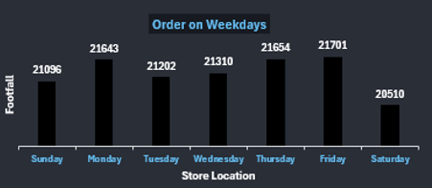
Sales Variation by Day and Hour
Day of the Week
Weekdays show higher footfall compared to weekends.
Peak footfall on Friday (21,701) and Thursday (21,564).
Hour of the Day
Highest order quantity around 10 AM.
Orders decline steadily after noon.

Slide 4
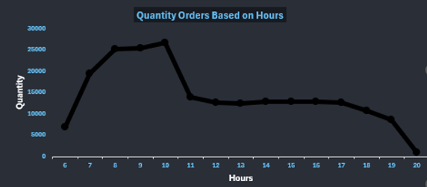
Peak Sales Times
Key Insight
10 AM is the peak time for sales activity.
Midday shows a slight secondary peak, followed by a steady decline.

Slide 5
Monthly Sales Overview
Total Sales: $698,812.33
Average Order per Person: 1.44
Average Bill per Person: $4.69
Month | Total Sales | Average Order per Person | Average Bill per Person
January | 81,677.74 | 1.44 | 4.72
February | 76,145.19 | 1.44 | 4.65
March | 98,834.68 | 1.43 | 4.66
April | 118,941.08 | 1.44 | 4.69
May | 156,727.76 | 1.44 | 4.67
June | 166,485.88 | 1.44 | 4.71

Slide 6
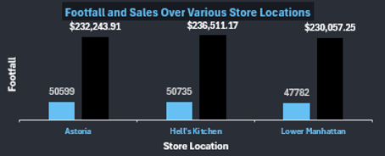
Sales by Store Location
Locations
Hell’s Kitchen: $236,511.17 in sales, 50,753 footfall.
Astoria: $232,243.91 in sales, 50,599 footfall.
Lower Manhattan: $230,057.25 in sales, 47,782 footfall.

Slide 7
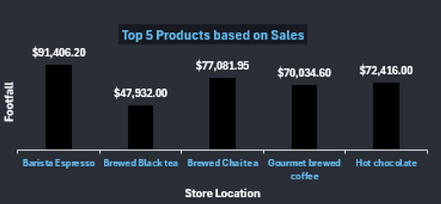
Bestselling Products
Top Products by Revenue
Barista Espresso: $91,406.20
Brewed Chai Tea: $77,081.95
Hot Chocolate: $72,416.00
Gourmet Brewed Coffee: $70,034.60

Slide 8
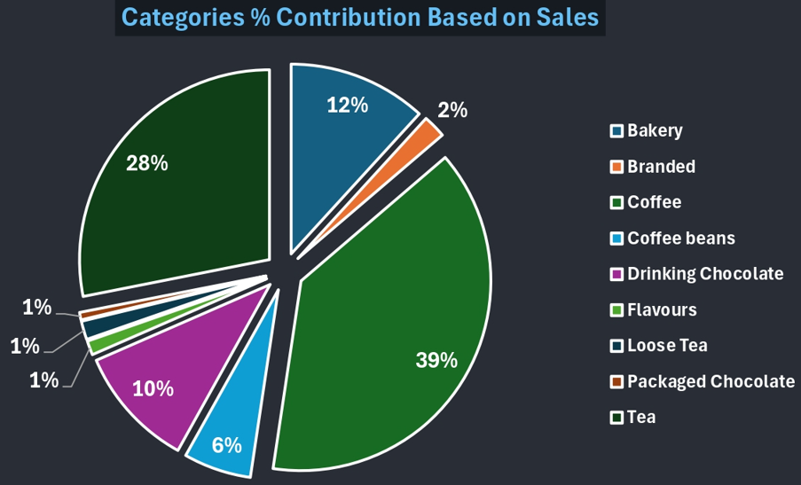
Sales by Product Category
Categories Breakdown
Coffee: 39%
Tea: 28%
Bakery: 12%
Drinking Chocolate: 10%
Smaller contributions from Braded, packaged chocolate, flavors, etc.

Slide 9
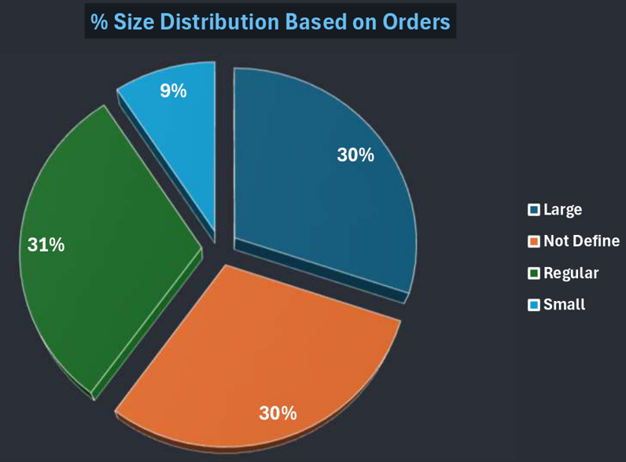
Size Distribution of Orders
Order Sizes
30% for Large
31% Regular
9% Small
30% Not Defined orders

Slide 10
Conclusion and Recommendations
Key Findings:
Focus on peak hours around 10 AM.
Enhance inventory for top-selling products like Barista Espresso and Brewed Chai Tea.
Leverage insights on popular categories Coffee and Tea.
Recommendations:
Increase staffing and resources during peak hours.
Target promotions on weekdays, especially around mid-morning.
Consider expanding high-footfall locations with additional stock.

